Slide 1
Welcome to the Mount Auburn Practice Improvement Program Community Learning Session
Please be sure to sign in!

Slide 2
“An Accident Waiting to Happen”
Recognizing and Reducing Risk in Office Practice Care
Mount Auburn Practice Improvement Program (MA-PIP)
Community Learning Session
October 21, 2016
Paula Griswold
Executive Director
Massachusetts Coalition for the Prevention of Medical Errors
Yvonne Cheung, MD, MPH, CPPS
Chair, Department of Quality and Patient Safety
Mount Auburn Hospital
Judy Ling
Coaching Consultant, MA-PIP

Slide 3
Learning Objectives
As a result of participating in this session, learners will be able to:
Recognize key patient safety issues in their own practice and describe foundational principles of patient safety.
Describe aspects of office practice communication that could lead to errors
Identify and employ strategies for engaging patients in improvement work

Slide 4
Disclosure statement
  Mount Auburn Hospital is accredited by The Massachusetts Medical Society (MMS) to provide AMA PRA Category 1 CME Credits™ to hospital activities developed to enhance and improve the practice of medicine. We endorse the ACCME Standards for Commercial Support™ and hereby state that none of the individuals in a position to control the content of this CME activity have any relevant financial relationships to disclose

Slide 5

Problem Solving Skills
Clear on what is the problem and goal.
  What is happening today = baseline.
  What is the target? By when?
Has small scale ideas to test.
  Test today! By next Tuesday!
Solve multiple problems at same time.
Let data tell you if you are improving.
Just how we solve problems…..not a special project.
“While all changes do not lead to improvement, all improvement requires change.”
IHI

Slide 6
“An Accident Waiting to Happen”
Recognizing and Reducing Risk in Office Practice Care
Mount Auburn Practice Improvement Program (MA-PIP)
Community Learning Session
October 21, 2016
Paula Griswold
Executive Director
Massachusetts Coalition for the Prevention of Medical Errors
Yvonne Cheung, MD, MPH, CPPS
Chair, Department of Quality and Patient Safety
Mount Auburn Hospital
Judy Ling
Coaching Consultant, MA-PIP

Slide 7
What drives good or bad outcomes for patients?
Daily work – everyday operations:
1. System Design
- are work processes well designed?
- are defined work processes followed?
2. Culture
Patient
Outcomes
Improving daily work:
1. Culture including commitment to safety
and continual learning
2. “See problems”
3. “Solve problems”

Slide 8
What drives good or bad outcomes for patients?
Daily work – everyday operations:
1. System Design
- are work processes well designed?
- are defined work processes followed?
2. Culture
Patient
Outcomes

Slide 9
Science of Patient Safety
Systems Design/Systems thinking
  Design of work processes
Culture of Safety

Slide 10
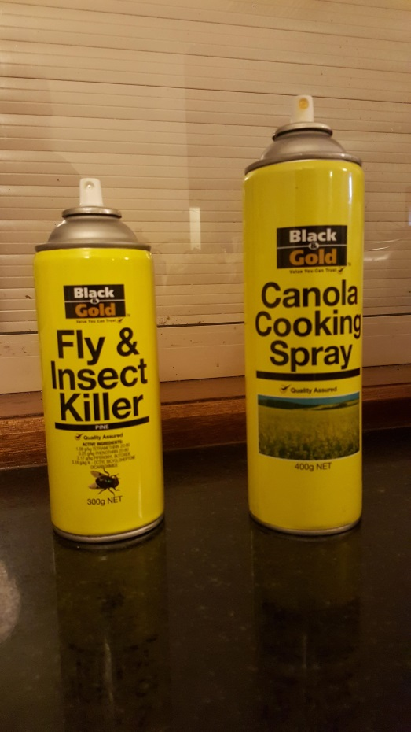
Designing Work Processes

Slide 11


Could you walk
downstairs
without falling?

Slide 12
Systems Thinking: If we want better performance, we must improve the system
Most problems in organizations do not come from individual workers.
Most problems come from the structure of the systems themselves.
People doing the work can’t produce better results if the problem is built into the system – the work processes
Notes:
Changing the people, or pushing them to "try harder" or "do better" will not result in improved performance.

Slide 13
Designing Work Processes
How can we make it easy
to do the right thing?
And hard to do the
wrong thing?

Slide 14
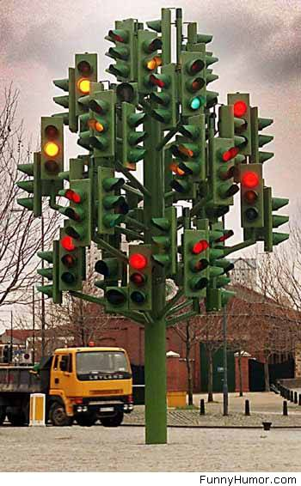
Systems Design
How do you “design” for safety?
Notes:
Pause -
Don’t worry – it’s just s sculpture, it’s not really supposed to provide signals to the traffic
This one isn’t going to cause error and harm

Slide 15

Notes:
Pause
Bad news – this is supposed to provide signals to the traffic in six lanes–
Complexity here has produced an accident waiting to happen; this is a system design problem
So those are the two core principles for safety
- systems designed for safety and reliability
- culture in which people
work as a team,
listen to each other,
and continually learn and improve
Now- what do we know about how we are doing in healthcare –
What does more recent work show about the level of harm?

Slide 16
Human Error Models
The “bad employee” model –
  “Names, blames, and shames" an individual(s) as "causing" the accident.
  Assumes mistakes and errors are the result of negligence, inattention, carelessness, lack of skill or knowledge, lack or motivation.
  This model uses fear and discipline to attempt to improve safety.
  “Bad things happen because of bad people."
Notes:
Person Model: This is the traditional approach to human error that "names, blames, and shames" an individual(s) as "causing" the accident. The underlying assumption is that mistakes and errors are the result of negligence, inattention, carelessness, lack of skill or knowledge, lack or motivation or one of a host of other faulty, negative mental processes. This model uses fear and discipline to attempt to improve safety. The person model considers errors as a "moral" issue that "bad things happen to bad people."*

Slide 17
Human Error Models
System model –
  Recognizes that systems cause most errors.
  Acknowledges that the organizational culture, design of work processes, can set workers up to fail. ("latent failures“)
  Recognizes human limitations and that humans make errors
  Systems should be designed to anticipate human error and avoid harm to the patient.
  “ High reliability organization”

Slide 18
What drives good or bad outcomes for patients?
Daily work – everyday operations:
1. System Design
- are work processes well designed?
- are defined work processes followed?
2. Culture
Patient
Outcomes

Slide 19
Culture
What’s “culture” mean to you?

Slide 20
Culture
“The way we do things around here”

Slide 21
Culture of Safety:
Key Aspects
Leadership & Values
A “Just” Culture/Psychological Safety
Communication
Teamwork
Staff Empowerment/Engagement
Patient/Family Engagement
Notes:
The most important aspects of safety culture comprises the human elements (as above) not just improvements in methods or technology

Slide 22

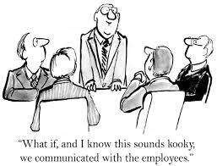
Culture eats Strategy for Breakfast

Slide 23
Improving Safety Culture
Tools/high engagement strategies for improving culture
Notes:
The following are a variety of techniques or ways to think about improving the safety culture in your practice. Something may strike a chord others may not seem to be applicable. The importance here is not to determine the one “right” way of improving the safety culture but to get you thinking about what would be the best way to start changing things in your practice.

Slide 24
Targeting Everyday Behaviors
How are errors being dealt with today?
How comfortable are staff with each other?
How are staff disagreements handled?
How are questions being answered ?

Slide 25
Other Strategies for Improving Culture
Get Rid of a Blame Culture
Identify What is Going Right
Develop a Process for Listening
Encourage Positive Behavior

Slide 26
What drives good or bad outcomes for patients?
Patient
Outcomes
Improving daily work:
1. Culture including commitment to safety
and continual learning
2. “See problems”
3. “Solve problems”

Slide 27
Improving Daily Work:
Another High Engagement Strategy
Culture includes continual learning
All staff “See problems”
Teams “ Solve Problems” – engage front line

Slide 28
Improving Daily Work:
Stop Putting out Same Fires Everyday!
Practice managers/staff - deal with familiar risks
  Sometimes feel stuck
  Feel “helpless” but fix it again to protect patient
Learning and using improvement skills
You are not helpless!
Notes:
Practice managers/staff - often dealing with familiar risks
that problem that just keeps popping up.
you figure out how to deal with it each time. And then again the next time and the next times.
Sometimes feel stuck - “what are you going to do?”
Feel “helpless” but we don’t want anyone to get hurt so we just fix it again.
This project is about giving you the improvement skills and the confidence to stop putting out fires and, instead, fix the problem once and for all!
If you can clearly state what the problem is and set an improvement aim, then you and your team can identify some changes that might fix the problem, test those changes, measure outcomes, and implement changes that work.

Slide 29
See Problems:
Opening our eyes Identifying risks
How do we recognize the “accident waiting to happen”?
(something that might harm a patient)
“ Near misses” or “ Good Catches” –
scary but valuable learning opportunities
  Understanding the causes can lead to a permanent solution
  Don’t need a hero – just a reliable process!
Notes:
But…. how do we maximize our own safety awareness?
….our ability to identify other risk, right in front of us?
One way is to look at “Near Misses” – one of those problems could have cause harm but someone – “our hero” – did something to stop it from happening – protecting the patient
“Near Misses” are scary and show our vulnerability but they are valuable learning opportunities
Unraveling what led to a “Near-Miss” let’s us do something permanent about it
No need for a hero – just a reliable process

Slide 30
How else can we learn about “defects” in our processes?
What are your ideas?

Slide 31
How else can we learn about “defects” in our processes?
Ask patients to bring their problems to your attention
Learn from patients that report problems or confusion – find out what is confusing them
Ask staff – every day, or at each staff meeting or huddle – if there are things they think could cause a problem for patients
Safety eyes - observe processes
Keep a “glitch list” – things to work on
Notes:
Ask patients to bring their experiences to your attention
Follow up with patients that report problems or confusion – find out what is confusing them
Ask staff – every day- at each staff meeting or huddle – if there are things they are concerned about
Keep a “glitch list” – things to work on

Slide 32
Examples of Safety Risks –
Your Ideas
Notes:
EPIC conversion
Make sure that Communication is identified

Slide 33
Communication
……or failure of communication
#1 Contributing Factor to
patient safety risk

Slide 34
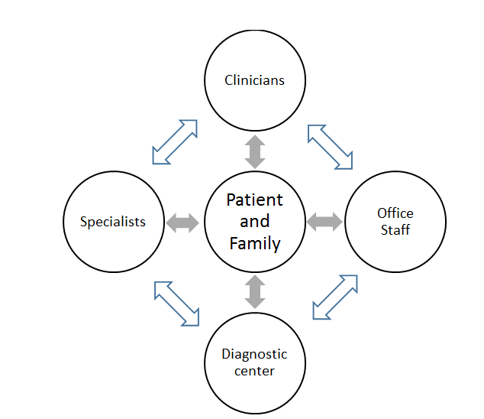
Communications that can Lead to Safety Risk

Slide 35
Communication That Can Lead to Safety Risk
Between Clinician and Patient
Interrupting the patient, before he/she describes all their symptoms
Not encouraging patient to describe problems with adherence to prior treatment plans
Missing new information on family history
Overlooking patient concerns with new treatment plan
No communication about danger signs to watch for
Assuming correct understanding of instructions
Not acknowledging if diagnosis is uncertain
Not checking if all issues were addressed
Notes:
Interrupting the patient and not hearing all the symptoms, leads to wrong diagnosis (Osler)
Not asking about concerns with the treatment plan, patient does not follow through
Not assuring correct understanding of instructions – unclear explanation, or just asking “ do you have any questions”
Not acknowledging uncertainty about diagnosis and explain the expected outcome and need for the patient to call and let the office know
Incomplete communication about danger signs to watch for with new medications, what to do
Didn’t check to see that all health issues were raised and discussed, left a problem unaddressed

Slide 36
Communication That Can Lead to Safety Risk
Between Practice Staff and Patient
Front desk staff didn’t collect information to assess urgency of need
Staff didn’t check with patient - plans for “next steps”
  Does patient understand what to do next?
  Are there barriers or concerns?
Asking “ yes or no” instead of open-ended questions – checking if patients had all their questions answered

Slide 37
Communication That Can Lead to Safety Risk
Between staff within the practice
Poor communication of patient concerns, changes in condition or medications
Not having staff meetings/using huddles/other reliable strategy to share a condition that is a risk for the day
“Hand-Offs” - Communication between staff across different offices
Inadequate communication of urgency for referrals or tests
No communication of specialist visit “no shows” to referring clinician

Slide 38
What drives good or bad outcomes for patients?
Patient
Outcomes
Improving daily work:
1. Culture including commitment to safety
and continual learning
2. “See problems”
3. “Solve problems”

Slide 39
Improving Daily Work:
See Problems → Solve Problems
Once recognize what could harm a patient:
  you can use the Model for Improvement and PDSA cycles to protect your patients by solving the problem once and for all

Slide 40
Patient Engagement
Clinical Relationship | Practice Improvement
Involve patients in their own care | Patients help identify problems, design and test improvements

Slide 41
Patient engagement is a key lever for improvement
Researchers at Academic Innovations Collaborative (Center for Primary Care, Harvard Medical School) working with primary care practices found:
  Teams were very reluctant
  Patient involvement surpassed expectations
  Putting patient on the team was critical step
* Singer, Sara J. PhD MBA, Principal Investigator, Harvard Chan, HMS, MGH, Presentation to the MA Coalition, September 29, 2016

Slide 42
Not just one patient
There is no ‘representative’ patient
More effective strategies
  Involve multiple patients
  Engage in multiple ways
    Focus groups
    Surveyed patients
    Encouraged input on the portal
    Other ideas

Slide 43
Engaging Patients
How do we engage patients in this work?
Patients’ perspective – identifying defects
Patients’ suggestions for improvements
Patients’ reaction to changes tested
Patients on your improvement team

Slide 44
Making Patient Engagement Effective
Patients are often unwilling to criticize!
“Culture of low expectations” – don’t expect much
Select “constructively discontented” patients and family members to involve
Script to encourage input – what topics, reaction to test
  “ We are working on improving X, it would really help us if you tell us what would make this better”

Slide 45
Patient Engagement Exercise
How could you encourage your patients to help you see risks?
In your current improvement work, how could involve patients?

Slide 46
What drives good or bad outcomes for patients?
Daily work – everyday operations:
1. System Design
- are work processes well designed?
- are defined work processes followed?
2. Culture
Patient
Outcomes
Improving daily work:
1. Culture including commitment to safety
and continual learning
2. “See problems” - Communication
3. “Solve problems”
Engage Patients

Slide 47
Summary
Patient Safety thrives in a culture where system issues are pursued as the root cause; not a culture of “blame” or relying on “heroes”.
Communication is the underpinning of many patient safety issues. Engaging patients in improvement reaps benefits that surpasses expectations.
See Problem, Solve Problems –Work with frontline staff, patients and your improvement teams to solve problems instead of putting out the same fires.
Say “Thank you!!” when patient safety problems are brought to you.

Slide 48
Evaluations
Thank you!

Slide 49
Additional Detailed Slides
Culture of Safety – slides 69-78
Improving Safety Culture – slides 79-86

Slide 50
Culture of Safety

Slide 51
Culture of Safety:
Key Aspects of an Organization
Leadership & Values
A “Just” Culture/Psychological Safety
Communication
Teamwork
Staff Empowerment/Engagement
Patient/Family Engagement
Notes:
The most important aspects of safety culture comprises the human elements (as above) not just improvements in methods or technology

Slide 52
Leadership & Values
Commit to consistently safe operations
Acknowledge risk - organization’s care processes could harm patients
Systems thinking - Recognize system contributions to harm & error
Encourage collaboration across all levels of staff/all roles to seek solutions to patient safety problems
Leadership provides resources to address safety concerns
Commitment to ongoing learning and improvement
Role model – “walk the talk”

Slide 53
A “Just Culture”/Psychological Safety
Identifies and addresses system issues – don’t punish individuals for issues caused by systems
Define unacceptable behavior/distinguish from mistakes (or “drift” to risky behavior)
  Reckless behavior: Intentionally disregarding reasonable rules or consistently refusing to change
  Zero tolerance for recklessness – from anyone
Build atmosphere of trust – drive out fear
Encourage/reward reporting of errors, near misses, concerns

Slide 54
Open communication
“Transparency” - Everyone is open about outcomes and errors
High comfort level with questions and input - shame is taken out of all discussions
Improvements are developed with all levels of staff and shared/explained with all staff
“Every defect is a gem” – learning from errors

Slide 55
Teamwork
Clear organizational values for teamwork:
  treat each other with respect
  pitch in to accomplish shared goals
  Speak up about safety in spite of hierarchy/power gradient

Slide 56
Staff Empowerment/Engagement
Front-line staff are the experts in their own work
  Include staff in improvement projects and audit teams
  All staff - “ unusual suspects”
Speak up about safety in spite of hierarchy/power gradient
Celebrate successes, acknowledge ideas contributions

Slide 57
Patient/Family Engagement
How do we engage patients in this work?
Empower patients to speak up in their own care
Patients’ perspective – identifying defects
Patients’ suggestions for improvements
Patients’ reaction to changes tested
Patients on your improvement team

Slide 58
Safety Culture Survey Questions Related to Risk
Staff feel like their mistakes are held against them
It is difficult to voice disagreement in this office
Staff are afraid to ask questions when something does not seem right

Slide 59
Discussing Safety Culture Survey Results Can Help Improve Safety
Teams that used semi-structured debriefing of culture survey results experienced a 10.2% reduction in infection rates
Teams that did not debrief survey results had a 2.2% reduction
    Vigorito, McNicoll, Adams, Sexton. Improving safety culture results in Rhode Island ICUs: lessons learned from the development of action-oriented plans. Jt Comm J Qual Patient Saf. 2011; 37(11): 509-14.

Slide 60
Improving Safety Culture
Tools/high engagement strategies for improving culture
Notes:
The following are a variety of techniques or ways to think about improving the safety culture in your practice. Something may strike a chord others may not seem to be applicable. The importance here is not to determine the one “right” way of improving the safety culture but to get you thinking about what would be the best way to start changing things in your practice.

Slide 61
Leadership:
It Can be Lonely at the Top
Leadership have a special ability to enhance or hurt the Safety Culture
Don’t take current perceived culture personally see it as an opportunity to improve
Practice what is preached, be opened about own mistakes
Recognize that all eyes are you

Slide 62
Get Rid of a Blame Culture
A culture of blame results in:
  Lack of personal responsibility or accountability
  Reluctance in staff to identify and report mistakes
  Reluctance in staff to self identify weaknesses and a seek help
  Increased blaming of others

Slide 63
Identify What is Going Right
Sometimes focusing on the good can increase desired behaviors
Praise, encourage and seek out questions from all staff
When concerns are raised immediately respond in a positive light and include that individual in planning possible improvements

Slide 64
Develop a Process for Listening
When someone brings to light a problem there needs to be a system to:
  Really listen (more than one person hearing the issue)
  Decide who is best to handle it
  Follow up with that person
    Thank them
    Tell them what did or did not change and why

Slide 65
Encourage Positive Behavior
  Respect
    Listen to each other, refrain from finger pointing
  Engagement
    Everyone should have a voice and interest in improving
  Psychological safety
    No official or unofficial reprimands for pointing out areas of improvement
  Prioritization
    Determine these as a group
  Responsiveness to concerns

Slide 66
Other Strategies for improving safety culture
Structured educational programs
Recognize that everyone is 100% responsible for the safety culture
Don’t personalize mistakes or corrections
Create an environment that celebrates suggestions and questions
Create a “Speak up” culture
Have a process to evaluate suggestions

Slide 67
What changes can we make?
Encourage and honor transparency
Implement “just culture”
Develop structured educational programs
Focus on self improvement
Don’t personalize mistakes or corrections
Create an environment that celebrates suggestions and questions
Create a “Speak up” culture—of “no blame”
Improved communications including listening
Have a process to evaluate suggestions
…and many others!!

